Slide 1
Web Design & Publishing
Biblical relationships
Exo. 20:1-17
Lk. 4:17
https://sites.google.com/a/babcock.edu.ng/maitanmi-lecture-site/

Slide 2
Web Design & Publishing
Lesson 1
Introduction
Over the past few years, the Web has become completely integrated into the fabric of society. Most businesses have Web sites, and it is uncommon to see a commercial on television that does not display a uniform resource locator (URL). The simple fact that most people now know what a URL is speaks volumes. People who did not know what the Internet was several years ago are now sending invitations using Web-based invitation services.

Slide 3
Advantages of taking this course
There is more than enough information on the Web about how to publish Web sites like a seasoned professional. There are tutorials, reference sites, tons of examples, and free tools to make it easier to publish on the Web. However, the advantage of taking this course instead is that all the information you need to build Web sites is organized in this course and presented in an orderly fashion. It has everything you need to master HTML, publish sites to a server on the Web, create graphics for use on the Web, and keep your sites running smoothly.

Slide 4
Objectives
At the end of this section, you would have learnt the following:
• What the World Wide Web is, and why it is really important
• What Web browsers do, and a couple of popular ones from which to choose
• What a Web server is, and why you need one
• Some information about uniform resource locators (URLs)
• Learn the differences between a Web server, a Web site, a Web page, and a home page
• Think about the information (content) you want to put on the Web
• Set the goals for the Web site
• Organize your content into the main topics
• Come up with a general structure for pages and topics

Slide 5
Definition of WWW
World Wide Web is a global, interactive, dynamic, cross-platform, distributed, graphical hypertext information system that runs over the Internet. Unless you understand all these words and how they fit together, this description may not make much sense.
The meaning of Hypertext
The Web Is a Hypertext Information System. The idea behind hypertext is that instead of reading text in a rigid, linear structure (such as a book), you can skip easily from one point to another. You can get more information, go back, jump to other topics, and navigate through the text based on what interests you at the time.
Hypertext enables you to read and navigate text and visual information in a non-linear way, based on what you want to know next.

Slide 6
The meaning of graphics
The Web was Graphically difficult to Navigate in the early days, using the Internet involved simple text-only applications. You had to navigate the Internet’s various services using typed commands and difficult tools. Although plenty of information was available on the Net, it was not necessarily pretty to look at. Then came the first graphical Web browser: Mosaic. It paved the way for the Web to display both text and graphics in full color on the same page. The ability to create complex, attractive pages which looks like those founds in books, magazines, and newspapers propelled the popularity of the Web. These days, the Web offers such a wide degree of capabilities that people are writing Web applications that replace desktop applications.

Slide 7
The meaning of Browser
A browser is used to view and navigate Web pages and other information on the World Wide Web. Currently, the most popular browser is Microsoft Internet Explorer. It’s considered a part of Microsoft Windows and a version of it is also bundled with Mac OS X.
The meaning of cross-platform
Cross-platform means that you can access Web information equally well from any computer hardware running any operating system using any display. The Web Is Cross-Platform If you can access the Internet, you can access the World Wide Web, regardless of whether you are working on a low-end PC or a fancy expensive workstation. More recently, people began accessing the Internet through their mobile phones, portable hand-held PCs, and personal information managers.

Slide 8
Definitions of web servers, web site and url
A Web server is just a computer that listens to requests from Web browsers and responds to that request.
A Web site is a location on the Web that publishes some kind of information. When you view a Web page, your browser connects to that Web site to get that information.
Each Web site, and each page or bit of information on that site, has a unique address. This address is called a uniform resource locator or URL. When people tell you to visit a site at http://www.bbcock.edu.ng, they have just given you a URL.
The Web Is Dynamic If you want a permanent copy of some information that is stored on the Web, you have to save it locally because the publisher (or anyone else with appropriate access to that server) can go back and change any of that information whenever he/she wants.

Slide 9
Example of Dynamic web site
Consider a book published and distributed entirely online, such as Thinking in Java by Bruce Eckel (which you can find at www.mindview.net/Books/TIJ/). He can correct any mistakes in the book and simply upload the revised text to his Web site, making it instantly available to his readers. He can document new features of Java and include them in the latest version of the book on his site.

Slide 10
Characteristics of the web
The web is distributive
The Web is successful in providing so much information because that information is distributed globally across thousands of Web sites, each of which contributes the space for the information it publishes. These sites reside on one or more computers, referred to as Web servers.
The Web Is Interactive
Interactivity is the capability to “talk back” to the Web server. More traditional media, such as television, is not interactive at in the slightest; all you do is sit and watch as shows are played at you. The Web is inherently interactive; the act of selecting a link and jumping to another Web page to go somewhere else on the Web is a form of interactivity.

Slide 11
Characteristics Cont’d
The Web Is Dynamic
If you want a permanent copy of some information that is stored on the Web, you have to save it locally because the publisher (or anyone else with appropriate access to that server) can go back and change any of that information whenever he/she wants.

Slide 12
Web Browser
A Web browser is the program you use to view pages and navigate the World Wide Web. Web browsers sometimes are called Web clients or other fancy names (Internet navigation tools), but Web browser is the most common term.
A wide array of Web browsers is available for just about every platform you can imagine. Most browsers are freeware or shareware (try before you buy) or have a lenient licensing policy.

Slide 13
Functions of the web browser
Any Web browser’s job is two folds. For hypertext Web documents, the browser must be able to communicate with the Web server. The browser deals with retrieving and displaying Web documents. Each Web page is a file written in a language called the Hypertext Markup Language (HTML) that includes the text of the page, its structure, and links to other documents, images, or other media.
The browser takes the information it gets from the Web server and formats and displays it for your system. Different browsers might format and display the same file in diverse ways, depending on the capabilities of that system and how the browser is configured. Retrieving documents from the Web and formatting them for your system are the two tasks that make up the core of a browser’s functionality.

Slide 14
Other Definitions
1. Web site: A collection of one or more Web pages linked together in a meaningful way that, as a whole, describes a body of information or creates an overall effect as shown in Figure 1.1 Each Web site is stored on a Web server.
2. Web server: A computer on the Internet or an intranet that delivers Web pages and other files in response to browser requests.
3.Web page: A single document on a Web site, usually consisting of an HTML document and any items that are displayed within that document, such as inline images.
3. Home page: The entry page for a Web site, which can link to additional pages on the same Web site or pages on other sites.

Slide 15
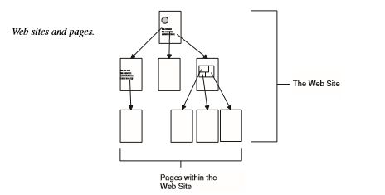
Home page
Figure 1.1

Slide 16
Content to display on the web
What you want to put on the Web is what I will refer to throughout this lecture as your content. Content is a general term that can refer to text, graphics, media, interactive forms, and so on. What sort of content can you put on the Web? Just about anything you want to. Here are some of the types of content that are popular on the Web right now:
• Stuff for work
• Personal information
• Hobbies or special interests
• Publications
• Company profiles
• Online documentation
• Shopping catalogs
• Online stores
• Polling and opinion gathering
• Online education
• Anything else that comes to your mind

Slide 17
Organize your content into the main topics
Break Up Your Content into Main Topics With your goals in mind, try to organize your content into main topics or sections, chunking related information together under a single topic. Sometimes the goals you came up with in the preceding section and your list of topics will be closely related. For example, if you’re putting together a Web page for car maintenance, the goal of being able to maintain the functionality of a vehicle fits nicely under a topic called, “Vehicle Maintenance” In this example, your topics might include the following:
• Change the oil and oil filter
• Check and adjust engine timing
• Check and adjust valve clearances
• Check and replace the spark plugs
• Check fluid levels, belts, and hoses
Don’t worry about the order of the steps or how you’re going to get your visitors to go from one section to another.

Slide 18
Web Site organisation Structures
Hierarchical structure Figure 1.2
Linear structure

Slide 19
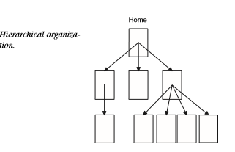
Figure 1.2

Slide 20
Linear
Another way to organize your documents is to use a linear or sequential organization, similar to how printed documents are organized. In a linear structure, as illustrated in Figure 1.3, the home page is the title or introduction, and each page follows sequentially from that structure. In a strict linear structure, links move from one page to another, typi cally forward and back. You also might want to include a link to Home that takes the user quickly back to the first page.
Context generally is easy to figure out in a linear structure simply because there are so few places to go.

Slide 21
Figure 1.3 Linear Organisation

Slide 22
Linear with alternatives
You can soften the rigidity of a linear structure by enabling the visitors to deviate from the main path. You could, for example, have a linear structure with alternatives that branch out from a single point Figure 1.4. The offshoots can then rejoin the main branch at some point further down, or they can continue down their separate tracks until they each come to an end.

Slide 23
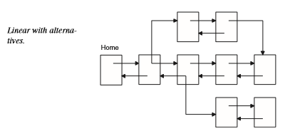
Figure 1.4 Linear with alternative

Slide 24
Combination of Linear and Hierarchical
A popular form of document organization on the
Web is a combination of a linear structure and
a hierarchical one, as shown in Figure 1.5 This
structure occurs most often when very
structured but linear documents are put online;
the popular Frequently Asked Questions
(FAQ) files use this structure.

Slide 25
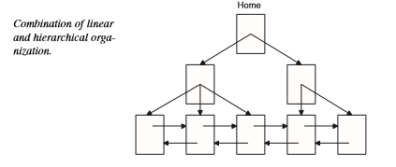
Figure 1.5 Combination of linear with Hierarchical

Slide 26
Web
A Web is a set of documents with little or no
actual overall structure; the only thing tying
each page together is a link Figure 1.6 Visitors
drift from document to document, following the
links around.

Slide 27
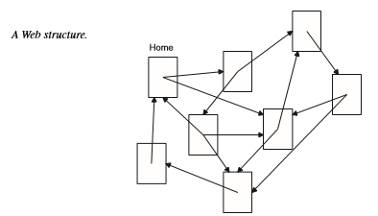
Figure 1.6 Web

Slide 28
Quiz
Question 1. Who runs the Web? Who controls all these protocols? Who is in charge of all these?
Question 2. I have heard that the Web changes so fast and that it is almost impossible to stay current, is this really true?
Question 3. What’s a URL?
Question 4. What’s required to publish documents on the Web?
Question 5. What if I don’t like any of the basic structures you talked about today?

